Slide 1

The objective of the Project is to analyze pizza sales data using SQL in order to uncover meaningful business insights such as top-selling products, peak sales hours, revenue trends, and customer ordering behavior — with the goal of supporting data-driven decision-making for sales growth and operational efficiency
PIZZA LAND SALES ANALYSIS
Presented by :
VISHAL SHETTY

Slide 2


Calculate Total number of orders placed

Slide 3
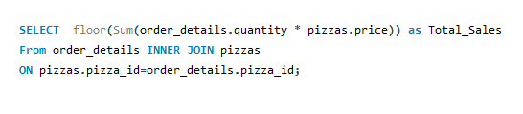

Calculate Total Revenue generated from pizza sales

Slide 4


Identify Total Pizzas Sold

Slide 5
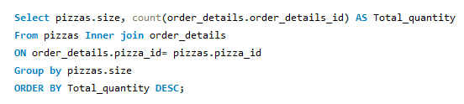
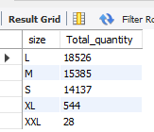
Identify pizzas ordered by size

Slide 6
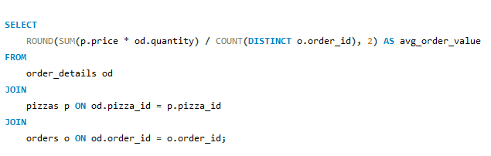

Calculate average order value

Slide 7
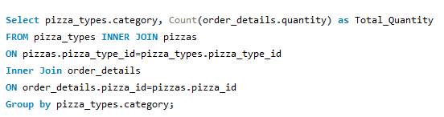
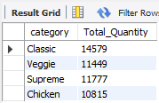
Find the total quantity of each pizza category ordered

Slide 8
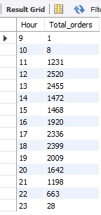

Determine the distribution of orders by hour of the day

Slide 9
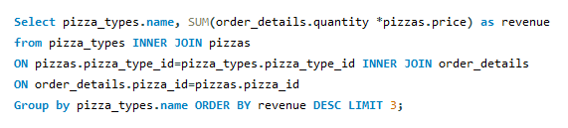
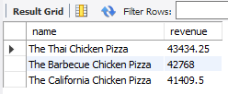
Determine the top 3 most ordered pizza types based on revenue

Slide 10
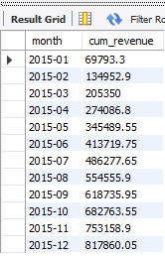
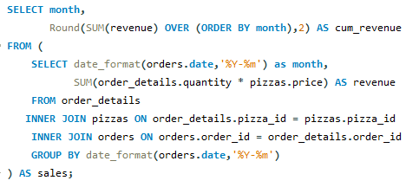
Analyze the cumulative revenue generated over time

Slide 11
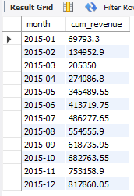
Calculate the percentage contribution of each pizza type to total revenue

Slide 12
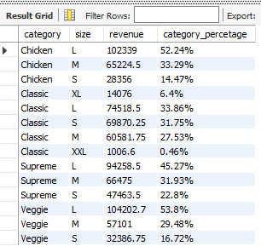
Find pizza size revenue contribution by each category

Slide 13
SQL helped uncover valuable patterns in pizza sales data. Identified top-selling pizzas, peak order times, and customer preferences. Analyzed revenue trends, average order values, and monthly growth. Data-driven insights can support better inventory planning, promotions, and customer targeting
CONCLUSION & KEY TAKEAWAY
THANK YOU !

